Slide 1


Slide 2

A trend analysis of conception statistics by age group in England and Wales
Notes:
Good afternoon! This presentation will look at discussing a trend analysis of conceptions statistics by age group in England and Wales.

Slide 3
Table of contents
4.
Dataset description
1.
Abstract
2.
5.
Introduction
Discussion
3.
Key terminology
Notes:
Abstract
Introduction
Key Terminology
Dataset Description
Discussion

Slide 4
1. Abstract
This presentation covers an analysis of the most recent version of the ”conception statistics” dataset (published in 2019 by the Office for National Statistics).
The analysis will be focusing particularly on how conception numbers have evolved over time and how this evolution can be understood through an age lens.
The analysis found that overall conception numbers in England and Wales have been decreasing for the past 5 consecutive years.
Concomitantly, for the 10th consecutive year, the number of conceptions for women under 30 as a subset of the total conceptions has been decreasing.
When looking through a marriage lens, it could be observed that women under 30 tend to conceive outside of marriage, whilst women over 30 tend to conceive within marriage.
Notes:
This presentation covers an analysis of the most recent version of the conception statistics dataset (published in 2019)
The analysis will be focusing particularly on how conception numbers have evolved over time and how this evolution can be understood through an age lens.
The analysis found that overall conception numbers in England and Wales are decreasing for the 5th consecutive year in 2019.
Concomitantly, for the 10th consecutive year, the number of conceptions for women under 30 as a subset of the total conceptions has been decreasing.
When looking through a marriage lens, it could be observed that women under 30 tend to conceive outside of marriage, whilst women over 30 tend to conceive within marriage.

Slide 5
2. Introduction
Scope
The dataset contains variables such as the number of conceptions, % of conceptions leading to abortions and the conception rate, all split by age group and year of conception.
Audience
This presentation is targeted towards a general audience.
Colour-blind friendly themes are utilised throughout the presentation for all visuals.
Considerations
Please note that this data excludes miscarriages which might impact some of the analysis on the % of conceptions leading to abortions.
It is also important to note that a conception does not have to result in birth and therefore the number of conceptions does not translate in actual births.
The dataset covers conception statistics from 1990-2019.
All charts have been produced in PowerBI.
Notes:
The Office for National Statistics publishes yearly conception statistics across England and Wales.
The following analysis focuses on the latest publication of these statistics (made in 2019) which covers all years from 1990 to 2019.
The data contains variables such as the number of conceptions, % of conceptions leading to abortions and the conception rate, all split by age group and year of conception.
This presentation is targeted towards a general audience.
Colour-blind friendly themes are utilised throughout the presentation for both charts and any other visuals.
Please note that this data excludes miscarriages which might impact some of the analysis on the % of conceptions leading to abortions
It is also important to note that a conception does not have to result in birth and therefore the number of conceptions does not translate in actual births.
All charts have been produced in PowerBI.

Slide 6
3. Key terminology
Terms and definition
Conception | The action of conceiving a child or of one being conceived (does not have to lead to birth necessarily).
Conception rate | The number of conceptions within the age group divided by the total number of women within the age group.
Age group | The particular age range to which the female belongs to.
Notes:
The action of conceiving a child or of one being conceived (does not have to lead to birth necessarily).
The number of conceptions within the age group divided by the total number of women within the age group.
The particular age range to which the female belongs to.
We will now move onto analysing the dataset.

Slide 7
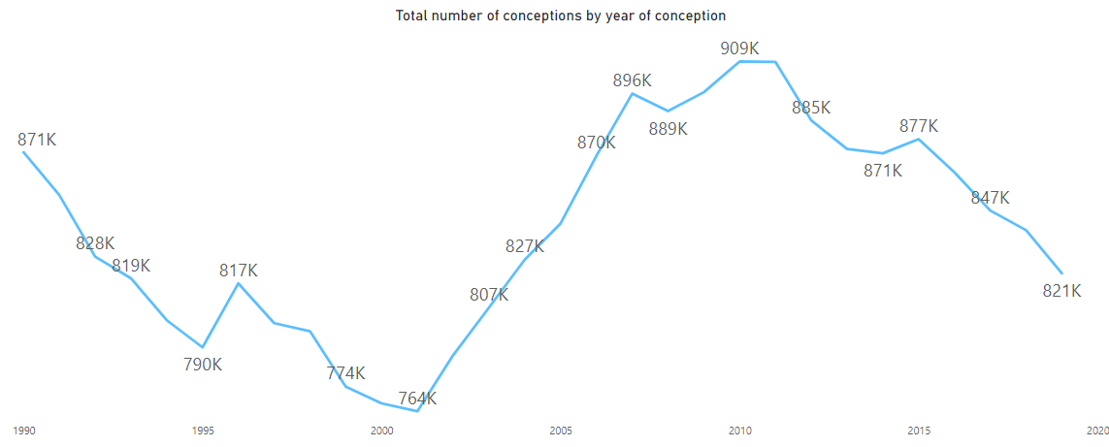
4. Dataset description Overall conception numbers are decreasing for the 5th consecutive year
Notes:
Overall, the conception numbers are decreasing for the 5th consecutive year.
In 2019, there was a 2.1% decrease in the number of overall conceptions compared with 2018.
This was the largest annual decrease since 2012.
But how has the number of conceptions over time been impacted by different age groups?

Slide 8
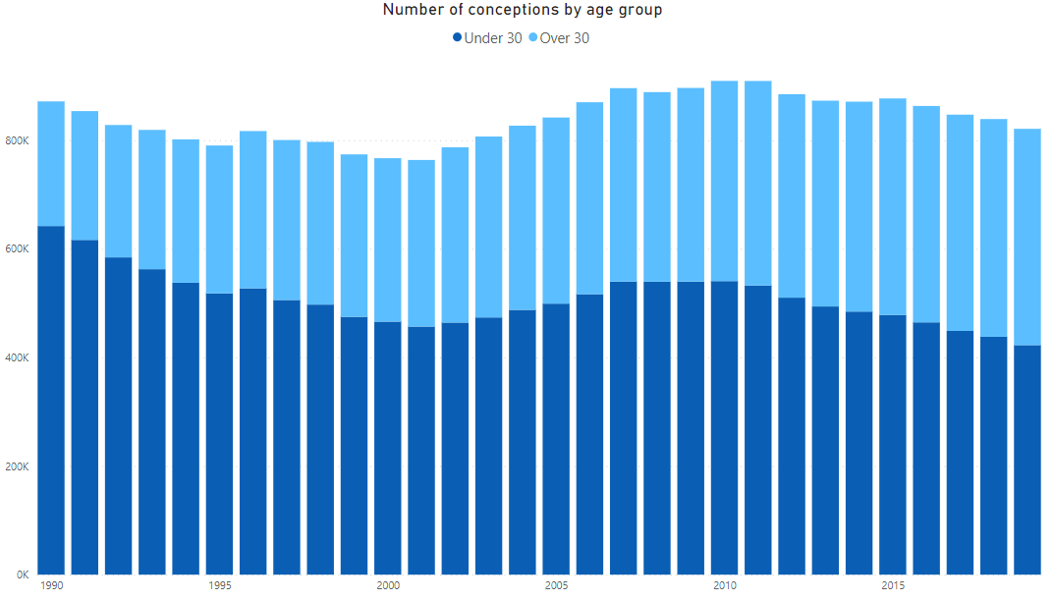
4. Dataset description Conceptions numbers are increasing for women over 30 for the 9th consecutive year
Notes:
Conception numbers are increasing for women over 30 for the 9th consecutive year.
On the opposite end, conception numbers for women under 30 have been consistently decreasing for the same time period.
So how do things look now compared to ten years ago?

Slide 9
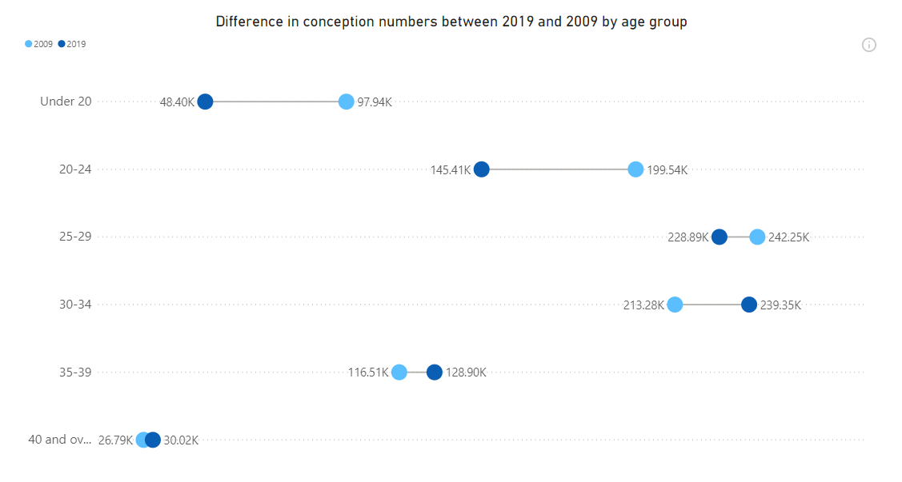
4. Dataset description The age trends in conception numbers have shifted around compared with 2009
2019
2009
40 and over
Notes:
When looking at the differences between 2019 and 2009, it becomes clearer that there has been a sift around when it comes to the age at which women conceive.
Thus, whilst 10 years ago conception numbers were driven by women under 30, the complete opposite is happening in 2019.
But does this trend reflect in the conception rates for these age groups?

Slide 10
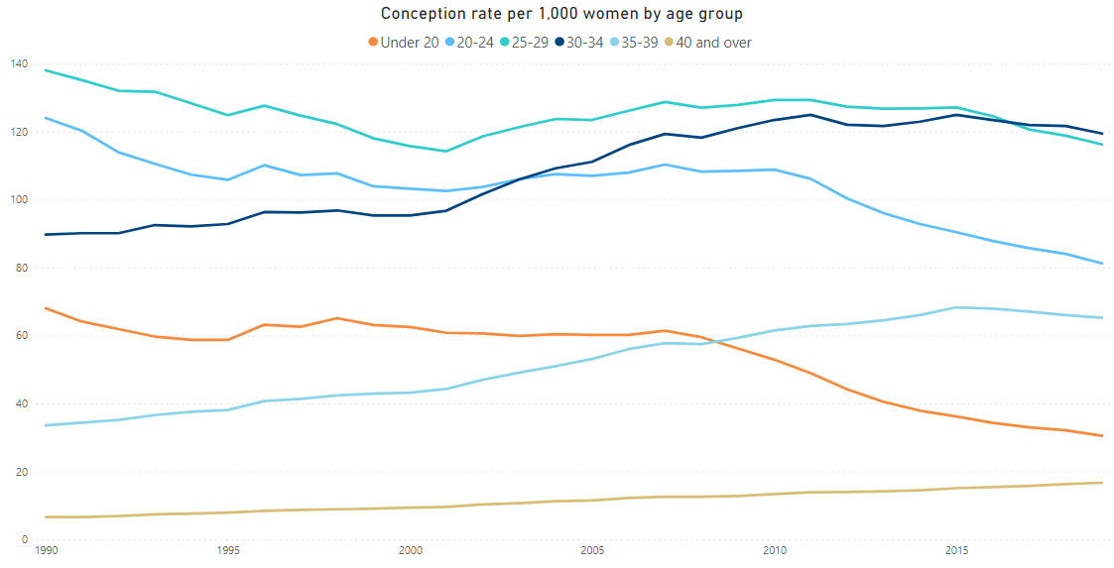
4. Dataset description Conception rates are at their lowest for women under 25 since records began
Notes:
We can see that there is a decline in the conception rates for women under 30.
Particularly for 2019, women under 25 have recorded the lowest conception rate since records began.
On the other hand, in 2019, the conception rate for women over 40 is at an all-time peak since records began.
Does this trend continue for abortion rates too?

Slide 11
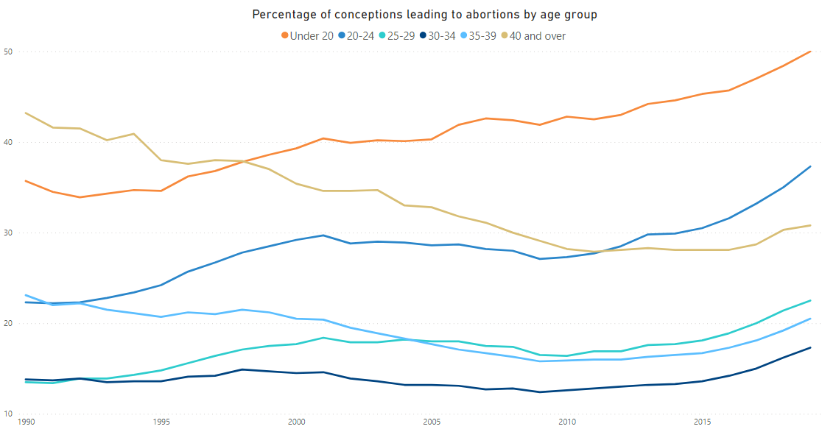
4. Dataset description Abortion rates have increased across all age groups for the 5th consecutive year
Notes:
Overall, abortion rates have increased across all age groups for the 5th consecutive year.
In terms of an age group breakdown, women between 30-39 have seen the lowest % increase when compared with other age groups, which further strengthens what we have seen in previous slides. Women over 30 tend to conceive more and also have less legal abortions.*
But do these trends change if we add a third variable – marriage?
*not includes miscarriages

Slide 12
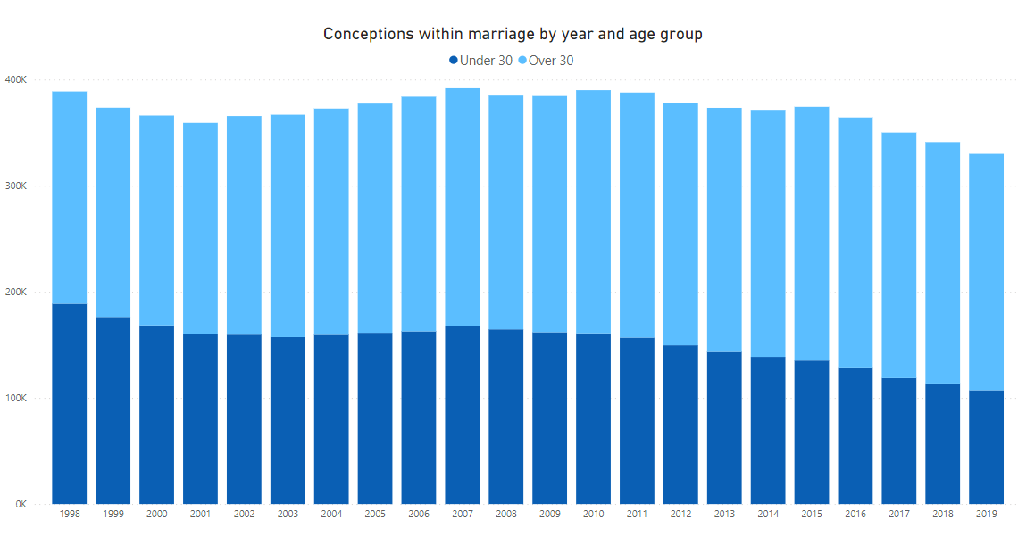
4. Dataset description Conceptions within marriage across all years are being driven by women over 30
Notes:
Across all years, it can be observed that the highest proportion of conceptions within marriage is historically being driven by women over 30.
But what about conceptions within marriage?

Slide 13
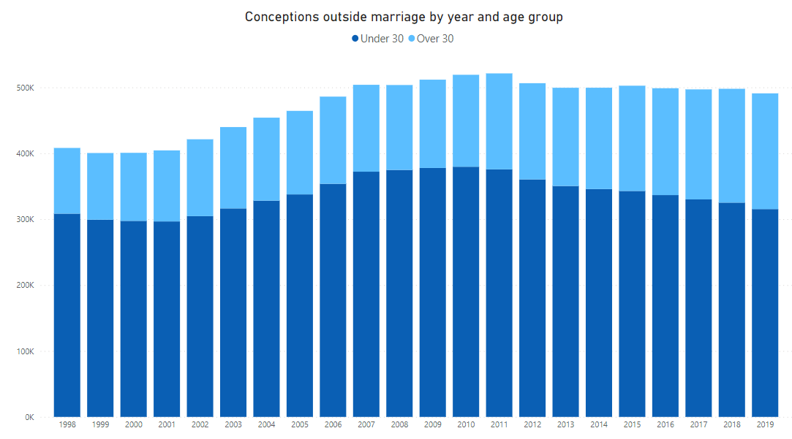
4. Dataset description Conceptions outside marriage across all years are being driven by women under 30
Notes:
Conceptions outside marriage have been historically driven by women under 30, 2019 marks the 5th consecutive year of decrease when it comes to this population’s % as a part of the whole.
However, do conceptions outside marriage lead to more or less abortions?

Slide 14




4. Dataset description In short , what does it all mean?
Less and less conceptions
Some age groups conceive more than others
The past 5 years have seen a continous decrease in the number of overall conceptions
Conception rates have been increasing for women over 30
More abortions for under 30s
Women conceive later in life and within marriage
Higher increases for conceptions leading to abortions for under 30s
Conceptions within marriage are driven by women over 30
Notes:
The past 5 years have seen a continuous decrease in the number of overall conceptions.
Whilst conception rates are decreasing for most ages, women over 30 are seeing smaller decreases compared with those under 30.
Women under 30 are recording higher increases for conceptions leading to abortions than those over 30.
Finally, conceptions within marriage are driven by women over 30.
I will not move onto discussing the rationale for utilising all of the above charts.

Slide 15

5. Discussion
Chart utilisation and rationale
In the following section, I will provide a rationale for the data visualization techniques which I have employed.
I will do this by discussing the available features of the dataset and the reason for choosing a particular data visualization technique.
Pittenturf’s (2018) principles were utilized when designing the aforementioned charts. Thus, charts should be informative, efficient, appealing, and interactive.

Slide 16
5. Discussion
Line charts
The utilisation of a line chart visualisation to showcase the number of conceptions allows the audience to quickly understand the evolution of conception trends over time.
As the time period for the dataset is quite large, line charts were preferred over bar charts to avoid visual clutter.
Notes:
The first chart type which was utilized was a line chart.
The utilisation of a line graph visualisation to showcase the number of conceptions allows the audience to quickly understand the evolution of conception trends over time.
As the time period for the dataset is quite large, line charts were preferred over bar charts to avoid visual clutter.

Slide 17
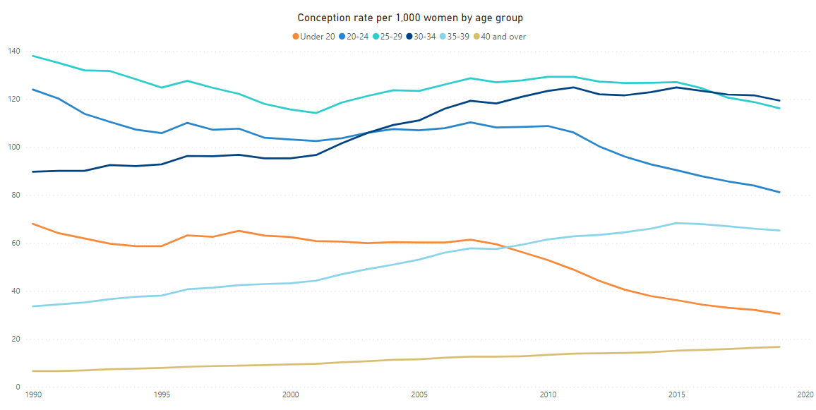
5. Discussion
Line charts
Secondly, line charts were also utilised to showcase the comparison between different ages groups when it comes to conception rates and percentages of conceptions leading to abortions.
As the metrics are either conceptions rates or percentages, line graphs were preferred over bar charts to avoid confusion for the audience when it comes to the axes.
Notes:
Line charts were also utilised to showcase the comparison between different ages groups when it comes to conception rates and percentages of conceptions leading to abortions.
As the metrics are either conceptions rates or percentages, line graphs were preferred over bar charts to avoid confusion for the audience when it comes to the axes.

Slide 18
5. Discussion
Dumbbell Dot Plots
The utilisation of dumbbell dot plots allowed the display of differences between groups at different points in time, which was ideal for showcasing how the age group division changed around between 2019 and 2009.
They are extremely effective at visualising the two datapoints in a compact way as well as showcasing the spread of the values (which further strengthens how conception trends have changed over time).
Notes:
Another chart type utilized was dumbbell dot plots.
Dumbbell dot plots — dot plots with two or more series of data — are an alternative to the clustered bar chart.
Dumbbell dot plots allow the display of differences between groups at different points in time, which was ideal for showcasing how the age group division changed around between 2019 and 2009.
The Dumbbell is very effective at visualizing two datasets across the same dimension in a compact and straightforward way. As a bonus, it also lets us check the spread of values (distribution) and their ranges (Anderson, 2017).
A simpler way of showing this would have been a grouped bar chart, with a bar for each year and grouped by age, however, the variation in the scale of the age groups means this is not a viable option.

Slide 19
5. Discussion
Bar charts – Stacked bar chart
.
Stacked bar charts were deemed ideal for showcasing both the evolution of the total number of conceptions over time, as well as which age group had the biggest impact on these totals.
Stacked bar charts were preferred over the following:
A) Line charts – do not showcase which age group impacted the totals over the years;
B) Bar charts – would not allow the display of multiple totals.
Notes:
As this analysis focused on showcasing how conception trends evolved through an age lens, another key visualization technique which was employed was the use of stacked bar charts.
Stacked bar charts were deemed ideal for showcasing both the evolution of the total number of conceptions over time, as well as which age group had the biggest impact on these totals.
Although (Ferreira, 2017) argues that line charts might be preferred over stacked bar charts, the total of the parts (in this case the age group) is extremely important, as it will allow the audience to fully grasp the idea that women are delaying childbearing until later ages.
As multiple totals are showcased over time, stacked bar charts were deemed to be preferred over simple bar charts.
The totals have short labels and therefore a stacked bar chart is preferred over a stacked column chart.
Finally, I will move onto discussing some general formatting techniques.

Slide 20
5. Discussion
General chart formatting-Data labels over axis
Some charts have data labels rather than axis.

Slide 21
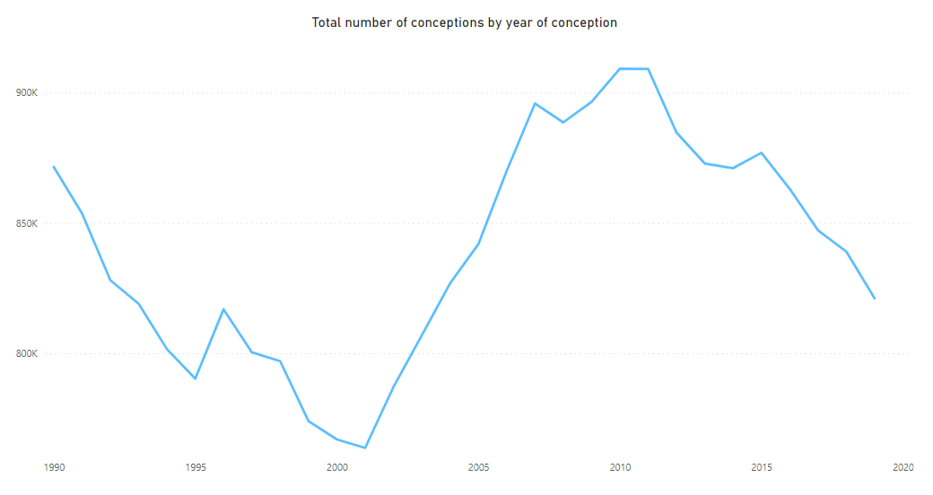
5. Discussion
General chart formatting-Data labels over axis
Here we can see the same chart with an Y-axis. If the audience would not look at the axis, it might appear that the year 2001 had an alarmingly small conception numbers, which is not the case.

Slide 22
5. Discussion
General chart formatting-Continuous X-axis rather than categorical
For line charts, data labels for the X-axis were represented continuously rather than categorically.

Slide 23
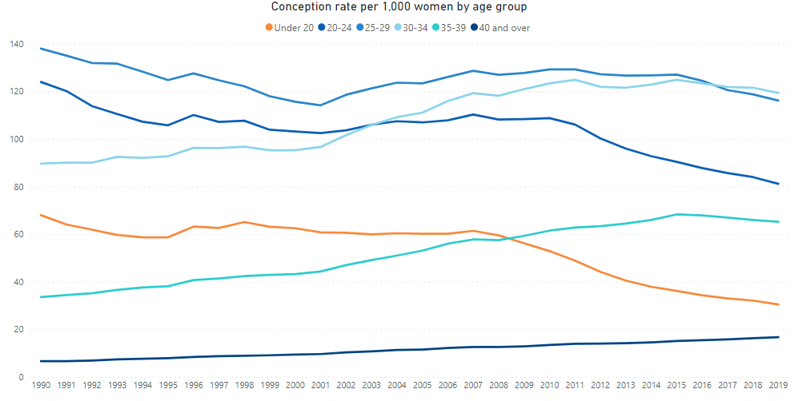
5. Discussion
General chart formatting-Continuous X-axis rather than categorical
Here we have the same chart with a categorical X-axis. As it can be seen, the visual is too cluttered and difficult to read.

Slide 24
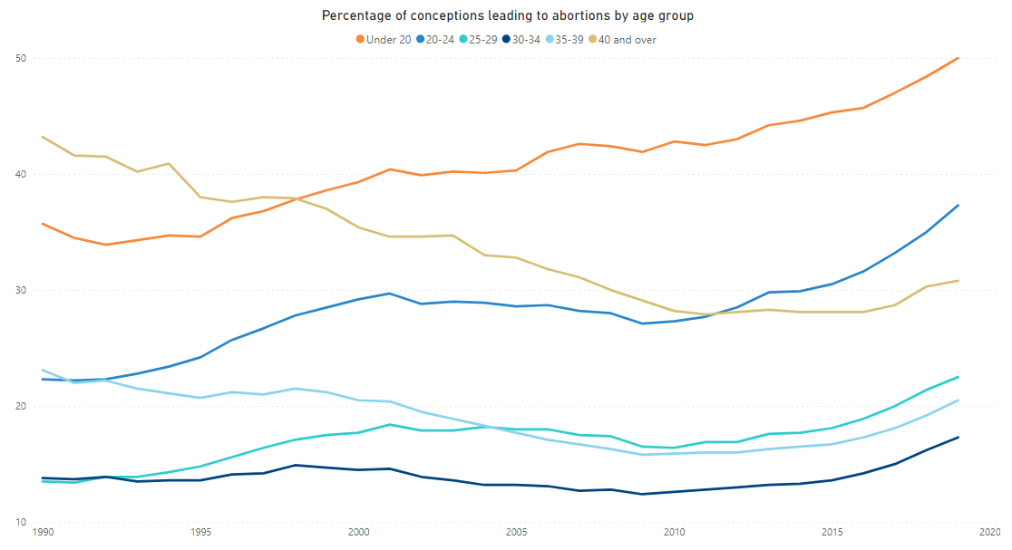
5. Discussion
General chart formatting- Y-axis might not start from 0
For some charts, the Y-axis does not start from 0, as there are no value close to 0 to represent.

Slide 25
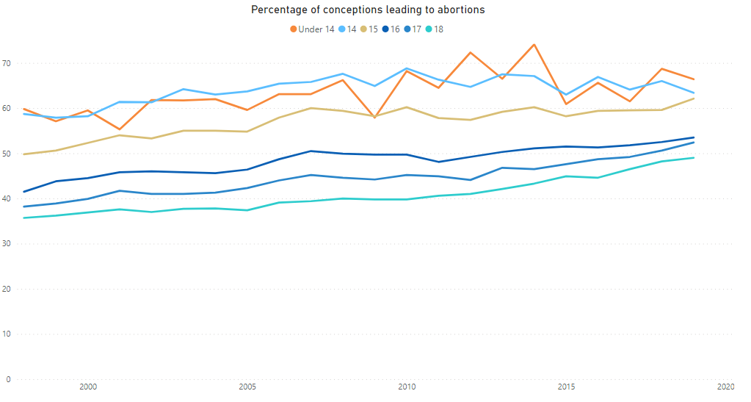
5. Discussion
General chart formatting- Y-axis might not start from 0
Here we can see the same chart with an axis that starts from 0 which is heavily skewed and confusing.

Slide 26
5. Discussion
General chart formatting- Creating a new age grouping method
A new age group split was created to easier differentiate those below 30 years old/those over 30 years old. This allows the audience to quickly understand which age group had the highest impact on the total numbers.

Slide 27
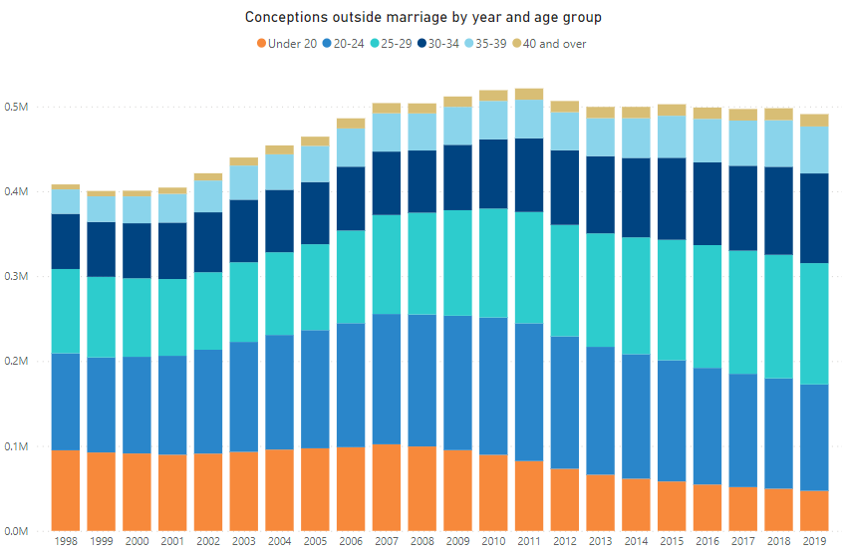
5. Discussion
General chart formatting- Creating a new age grouping method
Here we can see the same chart with the original ONS grouping. The chart is difficult to read for the average individual and might cause confusing and lead to potentially wrong conclusions.

Slide 28
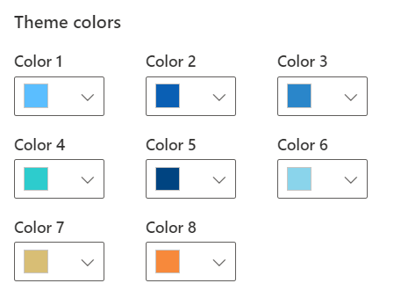
5. Discussion
Colour schema
To ensure ease of readability, the colour palette utilised throughout the presentation is colour-blind friendly (Jager, 2019).

Slide 29
Thank you for listening!

Slide 30
Appendix
The data, the PowerBI pbix file and an additional recording which details how to utilise PowerBI can be found here.

Slide 31
References
Pittenturf, Chris. 2018. “What Is Data Visualization and Why Is It Important?” https://data-visualization.cioreview.com/cxoinsight/what-is-data-visualization-and-why-is-it-important-nid-11806-cid-163.html.
Jager, Tom. 2019. “How to Optimize Charts For Color Blind Readers Using Color Blind Friendly Palettes.” https://venngage.com/blog/color-blind-friendly-palette/.
Anderson, Melissa. 2017. “Data Visualization and the 9 Fundamental Design Principles.” https://www.idashboards.com/blog/2017/07/26/data-visualization-and-the-9-fundamental-design-principles/.
Ferreira, Alysson. 2017. “A Ui Engineer’s Thoughts on Data Visualization Tools.” http://blog.avenuecode.com/a-ui-engineers-thoughts-on-data-visualization-tools.
Notes:
nkjnkjnjknkjjnnkj

